Slide 1
Sociology: 3549 Recap
Recitation #14
Yue Chu

Slide 2


Slide 3
announcement
Complete at least 11 lab assignments for bonus points.
Homework 4 is due Dec.2.
Please check class announcement in Carmen for grading policy.
Free Stats tutors – Peter and Lesley
https://osu.zoom.us/j/98745192052?pwd=WTUydnRsSlQ3bDhpY291MGFCWkJsdz09
Meeting ID: 987 4519 2052; Password: 647076
Dates and times in slide comments ↓
Notes:
Mondays: 12:30 - 3:30 pm
Tuesdays: Noon - 4 pm
Wednesdays: 9:30 am - 12:30 pm
Thursdays: 10 - 11 am and Noon - 4 pm
Fridays: 9:30 am - 2:30 pm

Slide 4
agenda
Review of lecture
Activity
Quick review of hypothesis testing
Stata
Stata log file for today’s attendance

Slide 5
Hypothesis testing
Testing difference in means / freq. distributions between groups.
Testing association between Independent var. (IV) and Dependent var. (DV).
Have population SD
Z-test
Research question & I.V, D.V.
I.V.: categorical D.V.: continuous
Two categories
Only have sample SD
T-test
More than two categories
ANOVA
I.V.: categorical D.V.: categorical
Chi-square test

Slide 6
Steps for test hypothesis
State
State hypothesis (H₀ vs H₁)
Sig.
Calculate
Collect sample and compute test statistics.
Decide
Whether reject / fail to reject H₀
Set significance level ($α$), and degree of freedom(s).
Set significance level (𝜶), and degree of freedom(s).
decide critical values & critical region.

Slide 7
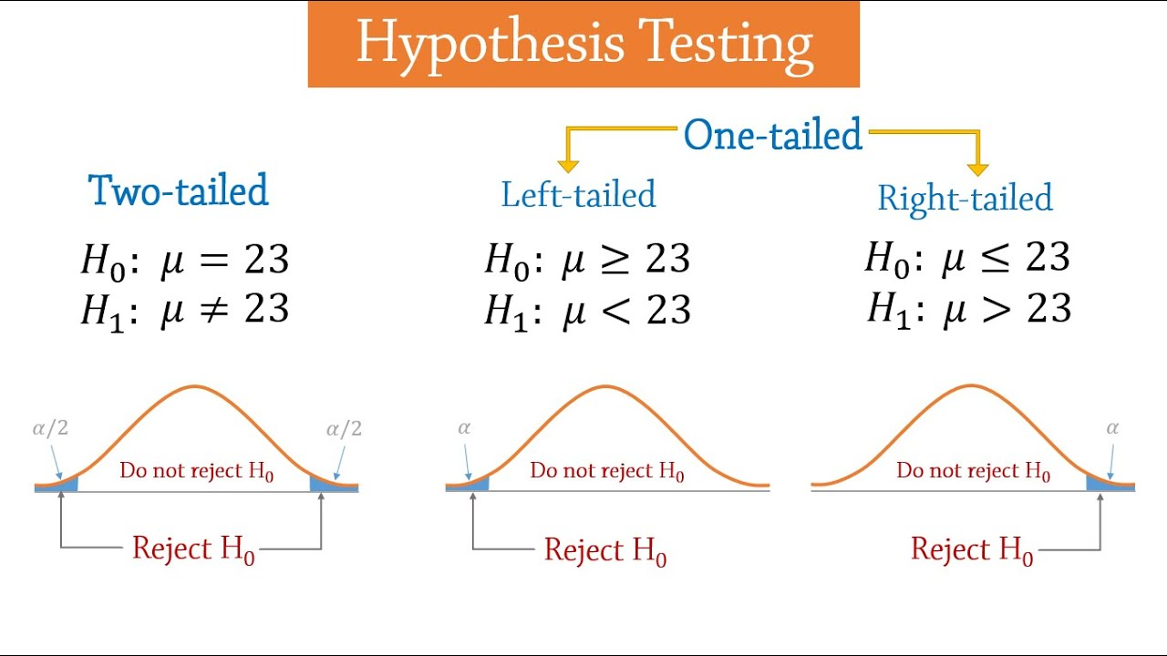
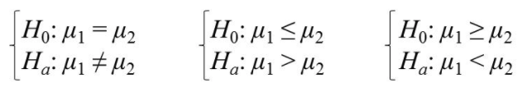
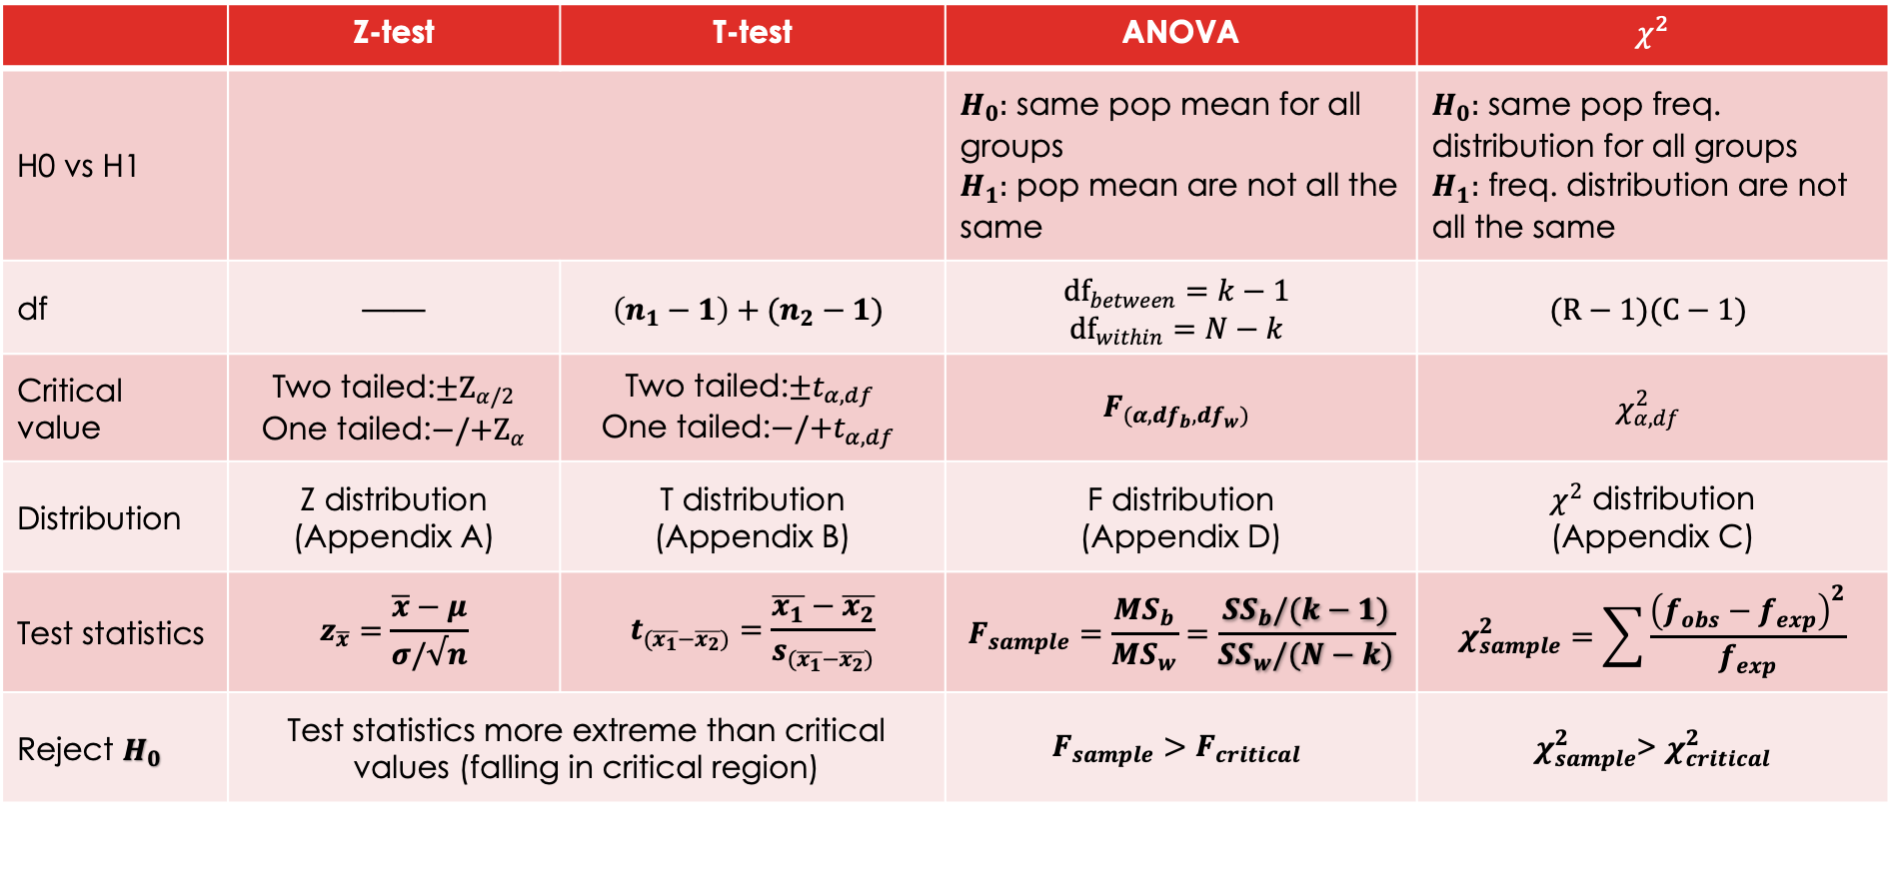
Summary table
 | Z-test | T-test | ANOVA | $χ^{2}$
H0 vs H1 |  |  | $H_{0}:$ same pop mean for all groups $H_{1}:$ pop mean are not all the same | $H_{0}:$ same pop freq. distribution for all groups $H_{1}:$ freq. distribution are not all the same
df | —— | $$\left(n_{1}−1\right)+(n_{2}−1)$$ | $${df}_{between}=k−1$$ $${df}_{within}=N−k$$ | $$(R−1)(C−1)$$
Critical value | Two tailed:$±Z_{α/2}$ One tailed:$−/{+Z}_{α}$ | Two tailed:${±t}_{α,df }$ One tailed:$−/+t_{α,df}$ | $$F_{(α, df_{b},df_{w})}$$ | $$χ_{α,df}^{2}$$
Distribution | Z distribution (Appendix A) | T distribution (Appendix B) | F distribution (Appendix D) | $χ^{2}$ distribution (Appendix C)
Test statistics | $$z_{\overline{x}}=\frac{\overline{x}−μ}{σ/√n}$$ | $$t_{(\overline{x_{1}}−\overline{x_{2}})}=\frac{\overline{x_{1}}−\overline{x_{2}}}{s_{(\overline{x_{1}}−\overline{x_{2}})}}$$ | $$F_{sample}=\frac{MS_{b}}{{MS}_{w}}=\frac{{SS}_{b}/(k−1)}{{SS}_{w}/(N−k)}$$ | $$χ_{sample}^{2}=\sum{\frac{{\left(f_{obs}−f_{exp}\right)}^{2}}{f_{exp}}}$$
Reject $H_{0}$ | Test statistics more extreme than critical values (falling in critical region) |  | $$F_{sample}>F_{critical}$$ | $χ_{sample}^{2}$> $χ_{critical}^{2}$

Slide 8

Common mistakes in homework
$H_{0}$ for one-tailed t-test: $μ_{1}≥μ_{2}$ or $μ_{1}≤μ_{2}$, not $μ_{1}=μ_{2}$
Your null and alternative hypothesis are mutually exclusive and exhaustive, in other words, combined covering all possible scenario.
Two sample t-test, if $n_{1}≠n_{2}$, you need to calculate pooled $s_{p}^{2}$ for SE based on sample SDs
$$s_{(\overline{x_{1}}−\overline{x_{2}})}=\sqrt{\left(\frac{s_{p}^{2}}{n_{1}}\right)+(\frac{s_{p}^{2}}{n_{2}})}$$
$$s_{p}^{2}=\frac{\left(n_{1}−1\right)s_{1}^{2}+(n_{2}−1)s_{2}^{2}}{\left(n_{1}−1\right)+(n_{2}−1)}$$

Slide 9
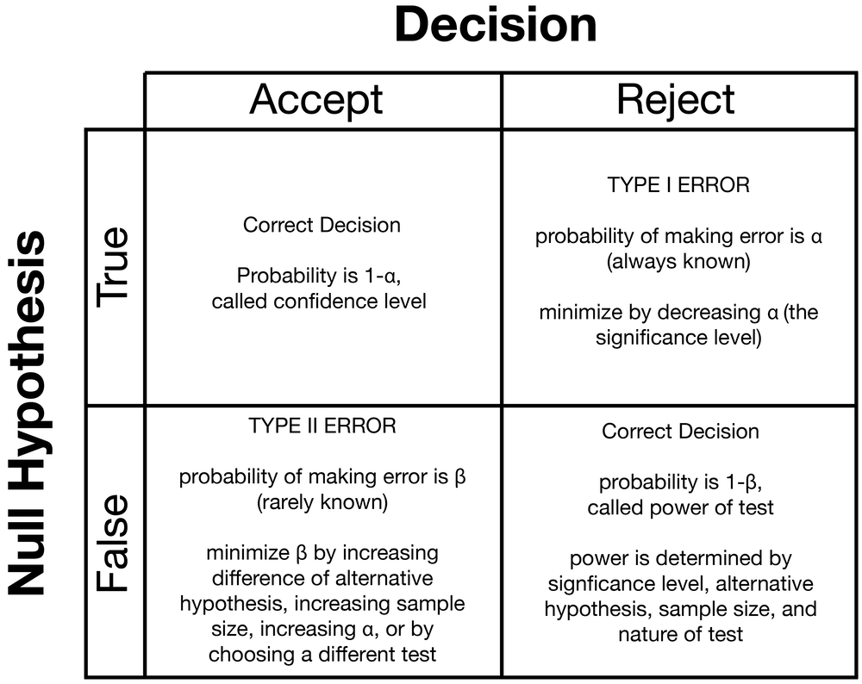

CI, confidence level and p-value
Your confidence interval always contains sample mean – that’s what you used to calculated CI in the first place
$$\overline{x}±t_{df,α}∙s_{\overline{x}}$$
For hypothesis testing, it’s a bit different
Confidence level is not the same as confidence interval
Confidence level is correctly accepting a true null hypothesis

Slide 10
